Slide 1
Word of the Day
Summer Term 2022
Week 32 – 23rd May 2022
'Words unlock the doors to a world of understanding...'

Slide 2
This Week's Words
Grasshopper
Shinobi
fence
approach
alley
magnificent
shelter
vain
greenhouse
fiend
allotment
suppress

Slide 3
Grasshopper (Tier 1)
fence
alley
shelter
greenhouse
allotment

Slide 4
Shinobi (Tier 2)
approach
magnificent
vain
fiend
suppress

Slide 5
Grasshopper Word of the Day
fence
Word Class
Word of the Day:
(noun)
(fence)
Pronunciation / Syllables
Definition:
A fence is a barrier between two areas of land, made of wood or wire supported by posts.
The fence was made from wood.
Phrases: | the fence surrounded | the solid fence
Synonym: | Antonym: | Rhyme: | Link Word:
barrier |  | sense | solid
rail |  | defence | damaged

Slide 6
Grasshopper Word of the Day
alley
Word Class
Word of the Day:
(noun)
(al-ley)
Pronunciation / Syllables
Definition:
An alley is a narrow passage or street with buildings or walls on both sides.
We used the alley to get there quicker.
Phrases: | through the narrow alley | a dark alley
Synonym: | Antonym: | Rhyme: | Link Word:
passage |  | valley | narrow
gully |  | rally | hidden

Slide 7
Grasshopper Word of the Day
shelter
Word Class
Word of the Day:
(noun / verb)
(shel-ter)
Pronunciation / Syllables
Definition:
A shelter is a small building or covered place which is made to protect people from bad weather or danger.
We took shelter from the rain under a tree.
Phrases: | quickly took shelter from | built a shelter from
Synonym: | Antonym: | Rhyme: | Link Word:
refuge | expose | belter | protective
protect | endanger |  | quickly

Slide 8
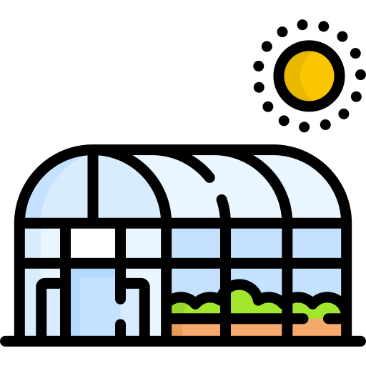
Grasshopper Word of the Day
greenhouse
Word Class
Word of the Day:
(verb / noun)
(green-house)
Pronunciation / Syllables
Definition:
A greenhouse is a glass building in which you grow plants that need to be protected from bad weather.
The greenhouse was great for growing vegetables.
Phrases: | the greenhouse reflected | clear greenhouse
Synonym: | Antonym: | Rhyme: | Link Word:
glasshouse |  |  | clear
 |  |  | see-through

Slide 9
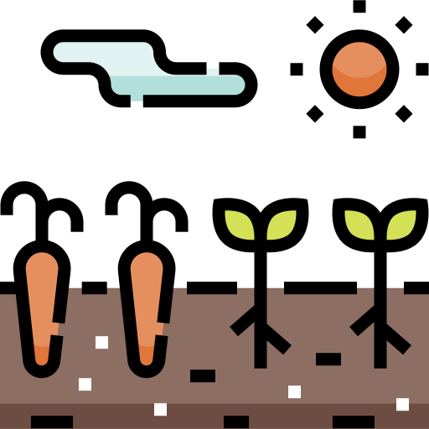
Grasshopper Word of the Day
allotment
Word Class
Word of the Day:
(noun)
(al-lot-ment)
Pronunciation / Syllables
Definition:
In Britain, an allotment is a small area of land in a town which a person rents to grow plants and vegetables on.
My grandma spends a lot of time at her allotment.
Phrases: | the productive allotment | the allotment grew
Synonym: | Antonym: | Rhyme: | Link Word:
 |  |  | fertile
 |  |  | productive

Slide 10
Shinobi Word of the Day
approach
Word Class
Word of the Day:
(noun / verb)
(ap-proach)
Pronunciation / Syllables
Definition:
Your approach to a task, problem, or situation is the way you deal with it or think about it. Or, when you approach something, you get closer to it.
Frank slowly approached the teacher.
Phrases: | slowly approached the | created a new approach to
Synonym: | Antonym: | Prefix / Suffix: | Rhyme: | Link Word:
strategy | leave | -ed | coach | slow
close in on |  | -ing | poach | tentative

Slide 11
Shinobi Word of the Day
magnificent
Word Class
Word of the Day:
(adjective)
(mag-nif-i-cent)
Pronunciation / Syllables
Definition:
If you say that something or someone is magnificent, you mean that you think they are extremely good, beautiful, or impressive.
The ancient, oak trees were magnificent.
Phrases: | overwhelming and magnificent | truly magnificent
Synonym: | Antonym: | Prefix / Suffix: | Rhyme: | Link Word:
spectacular | uninspiring | -ly |  | home
glorious | modest |  |  | kitchen

Slide 12
Shinobi Word of the Day
vain
Word Class
Word of the Day:
(adjective)
(vain)
Pronunciation / Syllables
Definition:
If you describe someone as vain, you are critical of their extreme pride in their own beauty, intelligence, or other good qualities.
Junior has become quite vain since his new haircut.
Phrases: | stared vainly into the mirror | vain and obsessed
Synonym: | Antonym: | Prefix / Suffix: | Rhyme: | Link Word:
conceited | modest | -ly | pain | person
self-obsessed |  |  | again | behaviour

Slide 13
Shinobi Word of the Day
fiend
Word Class
Word of the Day:
(noun)
(fiend)
Pronunciation / Syllables
Definition:
If you describe someone as a fiend, you mean that they are extremely wicked or cruel.
Jeremy decided to wear a fiendish costume.
Phrases: | dark and fiendish | a fiend
Synonym: | Antonym: | Prefix / Suffix: | Rhyme: | Link Word:
brute |  | -ish | leaned | person
swine |  | -ishly | cleaned | behaviour

Slide 14
Shinobi Word of the Day
suppress
Word Class
Word of the Day:
(verb)
(sup-press)
Pronunciation / Syllables
Definition:
If someone or something suppresses a process or activity, they stop it continuing or developing.
The spread of the virus was suppressed by wearing masks.
Phrases: | consistently suppress | suppress and slow
Synonym: | Antonym: | Prefix / Suffix | Rhyme: | Link Word:
subdue | incite | -ion | success | emotions
stifle | encourage | -ing | possess | spread

Slide 15
Vocabulary Laboratory
Describe / Definition:
Use it in a sentence:
Focus Word (write below):
Word Class:
Synonyms: (words with same / similar meaning) | Antonyms: (words with opposite meaning)
Rhymes: (words that sound the same) | Link Words: (Example: football = pitch, team, player)
Draw your sentence:

Slide 16
Vocabulary Visualiser
Draw the Grasshopper words and bring them to life.
Word: fence | Word: alley
Word: shelter | Word: allotment

Slide 17
Vocabulary Visualiser
Draw the Shinobi words and bring them to life.
Word: approach | Word: vain
Word: fiend | Word: suppress

Slide 18
Matching Meanings
Draw lines from the Grasshopper words to their definitions.
Grasshopper Word
fence
alley
shelter
greenhouse
allotment
Grasshopper Definitions
An *** is a narrow passage or street with buildings or walls on both sides.
A *** is a glass building in which you grow plants that need to be protected from bad weather.
A *** is a barrier between two areas of land, made of wood or wire supported by posts.
In Britain, an *** is a small area of land in a town which a person rents to grow plants and vegetables on.
A *** is a small building or covered place which is made to protect people from bad weather or danger.

Slide 19
Matching Meanings
Draw lines from the Shinobi words to their definitions.
Shinobi Word
approach
magnificent
vain
fiend
suppress
Shinobi Definitions
If you say that something or someone is ***, you mean that you think they are extremely good, beautiful, or impressive.
If you describe someone as a ***, you mean that they are extremely wicked or cruel.
If you describe someone as ***, you are critical of their extreme pride in their own beauty, intelligence, or other good qualities.
If someone or something *** a process or activity, they stop it continuing or developing.
Your *** to a task, problem, or situation is the way you deal with it or think about it. Or, when you *** something, you get closer to it.

Slide 20
Display Slips
The following slides are for classroom display. As you teach each Word of the Day, words can be displayed in the classroom to enable pupils to use the taught vocabulary in an independent manner.

Slide 21
fence
alley

Slide 22
shelter
greenhouse

Slide 23
allotment
approach

Slide 24
magnificent
vain

Slide 25
fiend
suppress

