Slide 1

EYFS
WORD OF THE DAY
Sample

Slide 2
The EYFS Word of the Day Resource provides practitioners with the opportunity to practise vital phonics skills whilst developing children’s understanding of early vocabulary. The resources closely follow the sequence of phoneme-grapheme correspondences outlined in the Letters and Sounds document and so is the perfect way to enhance phonics learning whilst developing an understanding of vocabulary.
Letters and Sounds Correspondence:
• Autumn 1st Half – Words with Phase 2 Grapheme-Phoneme Correspondences.
• Autumn 2nd Half - Words with Phase 3 Grapheme-Phoneme Correspondences.
• Spring 1st Half - Words with Phase 3 Grapheme-Phoneme Correspondences.
• Spring 2nd Half - Words with Phase 3 Grapheme-Phoneme Correspondences.
• Summer 1st Half - Words with Phase 4 Grapheme-Phoneme Correspondences.
• Summer 2nd Half - Words with Phase 4 Grapheme-Phoneme Correspondences.
Each day, the children will be given a simple definition of a phonetically decodable word, with sound buttons included. The children can then practise:
• Finding the rhyme – designed to develop children’s phonological awareness, children suggest words that rhyme with the newly learnt vocabulary.
• Phoneme Frames – allowing the children to segment the word into its composite phonemes in order to spell it.
• Pyramid Spellings – requiring the child to build the word one letter at a time, rather than segmenting into phonemes.
• How many syllables? – counting the number of syllables (chunks) in a word, helping with decoding (reading) and encoding (spelling) words, particularly longer ones.
• Write the caption – allowing children to apply the newly learnt vocabulary in a caption or sentence which also contains high frequency words and tricky words appropriate to the phonics phase. This promotes a more secure understanding of the given vocabulary.

Slide 3


Fledgling Word of the Day
Word of the Day: |  | Meaning/Definition: A piece of material used to cover the floor.
Find the Rhyme: fat tat cat |  | Pyramid Spelling:
Phoneme Frame:
How many syllables? 1 | Write the Caption: cat on a mat
m
ma
mat
m | a | t

Slide 4
Fledgling Word of the Day
Word of the Day: |  | Meaning/Definition: A piece of material used to cover the floor.
Find the Rhyme: |  | Pyramid Spelling:
Phoneme Frame:
How many syllables? | Write the Caption: _________________________________________________________

Slide 5

Fledgling Word of the Day
Word of the Day: |  | Meaning/Definition: A food made from fruit and sugar.
Find the Rhyme: cam am dam |  | Pyramid Spelling:
Phoneme Frame:
How many syllables? 1 | Write the Caption: jam in a jar
j
ja
jam
j | a | m

Slide 6
Fledgling Word of the Day
Word of the Day: |  | Meaning/Definition: A food made from fruit and sugar.
Find the Rhyme: |  | Pyramid Spelling:
Phoneme Frame:
How many syllables? | Write the Caption: _________________________________________________________

Slide 7

Fledgling Word of the Day
Word of the Day: |  | Meaning/Definition: A small motor vehicle used by the army.
Find the Rhyme: weep sleep sheep |  | Pyramid Spelling:
Phoneme Frame:
How many syllables? 1 | Write the Caption: a quick jeep
j
je
jee
jeep
j | ee | p

Slide 8
Fledgling Word of the Day
Word of the Day: |  | Meaning/Definition: A small motor vehicle used by the army.
Find the Rhyme: |  | Pyramid Spelling:
Phoneme Frame:
How many syllables? | Write the Caption: _________________________________________________________

Slide 9

Fledgling Word of the Day
Word of the Day: |  | Meaning/Definition: The den (home) of a wild animal such as bear or a wolf.
Find the Rhyme: chair fair dare |  | Pyramid Spelling:
Phoneme Frame:
How many syllables? 1 | Write the Caption: A pair of socks.
p
pa
pai
pair
p | air

Slide 10
Fledgling Word of the Day
Word of the Day: |  | Meaning/Definition: The den (home) of a wild animal such as bear or a wolf.
Find the Rhyme: |  | Pyramid Spelling:
Phoneme Frame:
How many syllables? | Write the Caption: _________________________________________________________

Slide 11
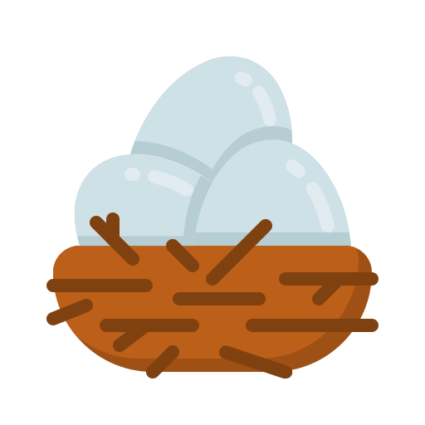
Fledgling Word of the Day
Word of the Day: |  | Meaning/Definition: A place built by birds using sticks and twigs where they lay their eggs.
Find the Rhyme: vest pest rest |  | Pyramid Spelling:
Phoneme Frame:
How many syllables? 1 | Write the Caption: A chick in a nest.
n
ne
nes
nest
n | e | s | t

Slide 12
Fledgling Word of the Day
Word of the Day: |  | Meaning/Definition: A place built by birds using sticks and twigs where they lay their eggs.
Find the Rhyme: |  | Pyramid Spelling:
Phoneme Frame:
How many syllables? | Write the Caption: _________________________________________________________

Slide 13

Fledgling Word of the Day
Word of the Day: |  | Meaning/Definition: A machine used to print out pages from a printer.
Find the Rhyme: dinner spinner winner |  | Pyramid Spelling:
Phoneme Frame:
How many syllables? 2 | Write the Caption: Send the task to the printer.
p
pr
pri
prin
print
printe
printer
p | r | i | n | t | er

Slide 14
Fledgling Word of the Day
Word of the Day: |  | Meaning/Definition: A machine used to print out pages from a printer.
Find the Rhyme: |  | Pyramid Spelling:
Phoneme Frame:
How many syllables? | Write the Caption: _________________________________________________________

